Slide 1
Roslyn Analyzers and Real World Code clones and disposing and oh my…
Joe Healy – Microsoft – Tampa, FL
Cloud Solution Architect
jhealy@microsoft.com

Slide 2

“The Horror, the Horror.”

Slide 3

Hi, I used Roslyn Analyzers to find this bug. And I’m sooo happy!

Slide 4
WARNING
The following presentation contains real code snippets from customer project
Namespaces and functionality may have been changed to protect the guilty
If you are a coding purist leave now
If you are on the C# team leave now
If you were a “software craftsman” leave now

Slide 5

Code Clone Analysis

Slide 6
Code Clone Analysis
NOT Roslyn but darned useful
Built into VS2015+ Enterprise
Fragments of code that are exact or similar across a solution
Common across apps that have been hurried or evolved over time
Create difficulties in maintenance
Good items to refactor

Slide 7
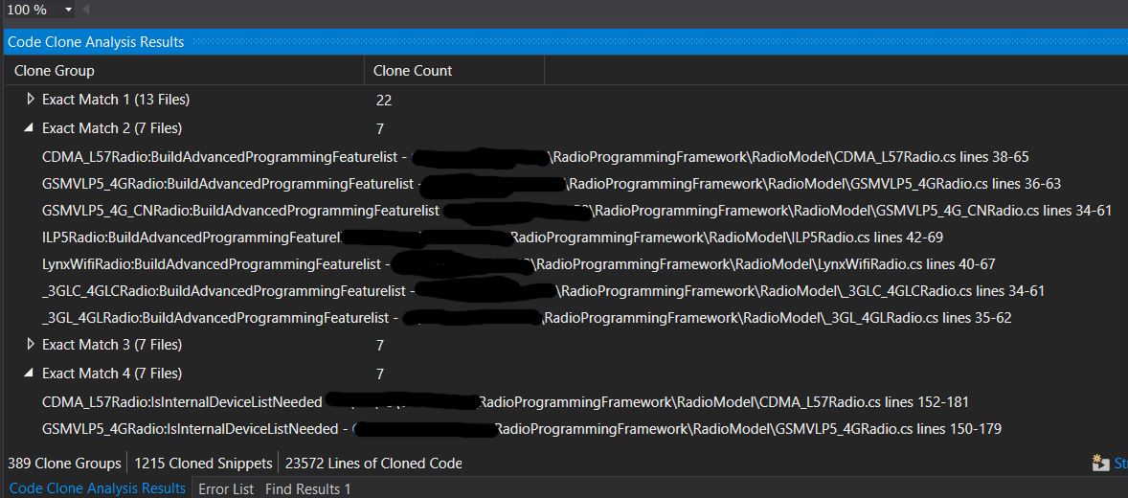
Execute Code Clone Analysis
Analyze > Analyze Solution for Code Clones
May require a “clean” of solution
Can take a while. Coffee/tea break recommended.

Slide 8
CultureInfo
22 clones, 13 files – some clones inside the same file
string[] languages = Request.UserLanguages;
if (languages.Count() > 0)
{
try
{
cultreInfo = new CultureInfo(languages[0]);
}
catch (CultureNotFoundException)
{
cultreInfo = CultureInfo.InvariantCulture;
}
}
else
cultreInfo = CultureInfo.InvariantCulture;
Web > EnumerableProofs.cs

Slide 9
RadioModel
7 clones
AdvancedDeviceProgrammingFeaturesList = new List<IFeature>();
AdvancedDeviceProgrammingFeaturesList.Add(_featuresFactory.CreateSupervisionFeature());
AdvancedDeviceProgrammingFeaturesList.Add(_featuresFactory.CreateLocalProgrammingFeature());
AdvancedDeviceProgrammingFeaturesList.Add(_featuresFactory.CreateOldAlarmTimeFeature());
AdvancedDeviceProgrammingFeaturesList.Add(_featuresFactory.CreateTwoWayVoiceFeature());
AdvancedDeviceProgrammingFeaturesList.Add(_featuresFactory.CreateHighUsagePlanFeature());
AdvancedDeviceProgrammingFeaturesList.Add(_featuresFactory.CreateInternalDeviceFeature());
AdvancedDeviceProgrammingFeaturesList.Add(_featuresFactory.CreateUL864CommercialFireFeature());
AdvancedDeviceProgrammingFeaturesList.Add(_featuresFactory.CreateBellOutConnectFeature());
dvancedDeviceProgrammingFeaturesList.Add(_featuresFactory.CreateDirectWireAddressFeature());
AdvancedDeviceProgrammingFeaturesList.Add(_featuresFactory.CreateFaultRelayFeature());
AdvancedDeviceProgrammingFeaturesList.Add(_featuresFactory.CreateAPLFeature());
AdvancedDeviceProgrammingFeaturesList.Add(_featuresFactory.CreateCompassOverWirelessFeature());
AdvancedDeviceProgrammingFeaturesList.Add(_featuresFactory.CreateECPAddressFeature());
AdvancedDeviceProgrammingFeaturesList.Add(_featuresFactory.CreateIPConnectionFeature());
AdvancedDeviceProgrammingFeaturesList.Add(_featuresFactory.CreateGSMSupervisionRollOverFeature());
AdvancedDeviceProgrammingFeaturesList.Add(_featuresFactory.CreateIcontrolFeature());
AdvancedDeviceProgrammingFeaturesList.Add(_featuresFactory.CreateZonesFeature());
AdvancedDeviceProgrammingFeaturesList.Add(_featuresFactory.CreateRemoteServicesFeature());
AdvancedDeviceProgrammingFeaturesList.Add(_featuresFactory.CreateKeyPadTypeFeature());
AdvancedDeviceProgrammingFeaturesList.Add(_featuresFactory.CreateMultiPartitionFeature());
AdvancedDeviceProgrammingFeaturesList.Add(_featuresFactory.CreateMultiModeFeature());
AdvancedDeviceProgrammingFeaturesList.Add(_featuresFactory.CreateMultiModeAddressFeature());
AdvancedDeviceProgrammingFeaturesList.Add(_featuresFactory.CreateEthernetPowerSaveFeature());

Slide 10
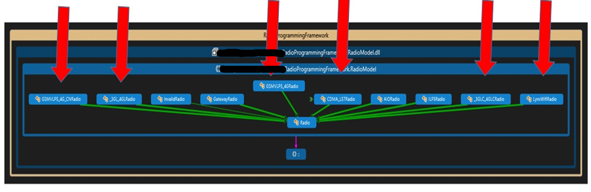
RadioModel Cloned in all these classes
7 clones

Slide 11
Same Code, Same File
AccountManagementController.cs in lines 1078-1092, as well as 1171-1185
CommProgrammingController.cs, lines 83-878 as well as 888-902
private CommunicatorDetailModel GetCommunicatorDetails(Account account)
{
CommunicatorDetailModel commDetail = new CommunicatorDetailModel();
string[] languages = Request.UserLanguages;
if (languages.Count() > 0)
{
try
{
cultreInfo = new CultureInfo(languages[0]);
}
catch (CultureNotFoundException)
{
cultreInfo = CultureInfo.InvariantCulture;
}
}
else
cultreInfo = CultureInfo.InvariantCulture;
private CommunicatorDetailModel GetCommunicatorDetails(Account account)
{
CommunicatorDetailModel commDetail = new CommunicatorDetailModel();
string[] languages = Request.UserLanguages;
if (languages.Count() > 0)
{
try
{
cultreInfo = new CultureInfo(languages[0]);
}
catch (CultureNotFoundException)
{
cultreInfo = CultureInfo.InvariantCulture;
}
}
else
cultreInfo = CultureInfo.InvariantCulture;

Slide 12
ValidateEmailRegEx
Can anyone tell me the RegEx to validate an email?

Slide 13
ValidateEmail RegEx
Reproduced 3 times. Not trivial client custom logic
bool retVal = false;
// regex source msdn.microsoft.com/en-us/library/01escwtf.aspx
// updated regex per RFC 2822 to include "/" and "_"
// exclude "&" to prevent appending of "amp" from flash, "&" is part of RFC 2822
// special characters currently allowed . @ ! # $ % ' * + - / = ? ^ _ ` { | } ~
string expr = @"^(?("")("".+?""@)|(([0-9a-zA-Z-!#\$%/_'\*\+/=\?\^`\{\}\|~]((\.(?!\.))" +
@"|[-!#\$%/_'\*\+/=\?\^`\{\}\|~\w])*)(?<=[0-9a-zA-Z-!#\$%/_'\*\+/=\?\^`\{\}\|~])@))" +
@"(?(\[)(\[(\d{1,3}\.){3}\d{1,3}\])|(([0-9a-zA-Z][-\w]*[0-9a-zA-Z]*\.)+[a-zA-Z]{2,6}))$";
Regex emailExpr = new Regex(expr);
string expr1 = @"^.{6,255}$";
Regex emailExpr1 = new Regex(expr1);
if (!String.IsNullOrEmpty(email.Trim()))
{
//EmailAddress validation
if (emailExpr.IsMatch(email.Trim()) && emailExpr1.IsMatch(email.Trim()))
{
retVal = true;
}
else
{
retVal = false;
}
}
return retVal;

Slide 14
Cloned Code Analysis
DEMO

Slide 15
Portability Analyzer for .NET Core

Slide 16
Portabililty Analyzer
Install from Extensions and Updates
Excel report on how ready your code is

Slide 17
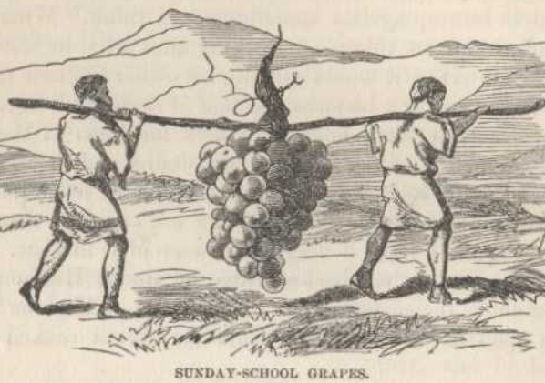
Portability Analyzer
DEMO

Slide 18
Live Static Code Analysis

Slide 19
Live Static Code Analyzer
Live – as you work – Roslyn brought LIVE
IN YOUR FACE warnings and errors
Improve coding skills while devs work
Work against “rules”

Slide 20
DEMO: Analyzers in Action

Slide 21
Enabling core analyzers
Pre-VS2019 16.8 and/or < .NET 5.0
Install Microsoft.CodeAnalysis.NetAnalyzers Nuget
VS2019 16.8 and/or > .NET 5.0
VS 2019 16.8 and .NET 5.0> analyzers included with .NET SDK.
Set MSBuild EnableNETAnalyzers=true
<PropertyGroup> <EnableNETAnalyzers>true</EnableNETAnalyzers>
</PropertyGroup>
Notes:
https://docs.microsoft.com/en-us/visualstudio/code-quality/install-net-analyzers?view=vs-2019

Slide 22
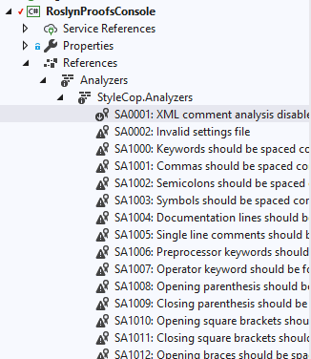
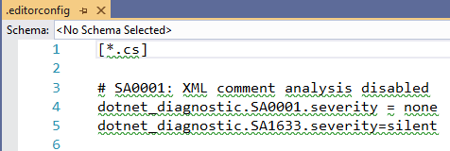
3rd Party Analyzers
Nuget
Install package into project using Visual Studio or Package Manager
Solutions Explorer -> References > Analyzers
Adjust rules in IDE to build out rulesets (.editorconfig)

Slide 23
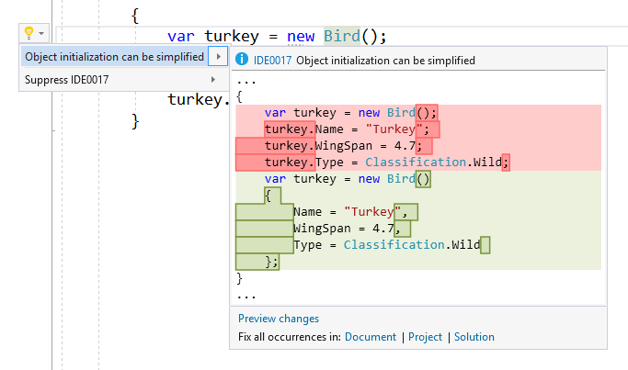

VS2017 – IDE0017 – Object Initialization
Simplify object initialization with an initializer
Cons > AnimalFactory.cs
Notes:
https://www.visualstudio.com/en-us/news/releasenotes/vs2017-relnotes

Slide 24
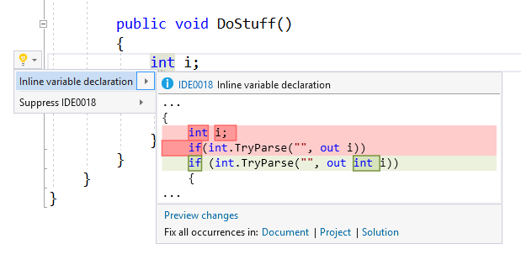
VS2017 – IDE0018 – out var
Move out vars inline using new c#7
Cons > AnimalFactory.cs
Notes:
https://www.visualstudio.com/en-us/news/releasenotes/vs2017-relnotes

Slide 25
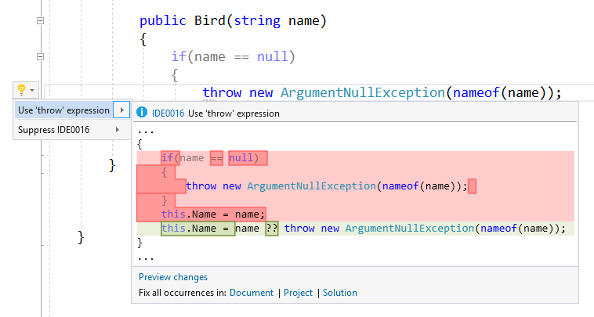
VS2017 – IDE0016 – Simplify nul lchecks
Simplify null checks with null coalescing
Cons > Bird.cs
Notes:
https://www.visualstudio.com/en-us/news/releasenotes/vs2017-relnotes

Slide 26
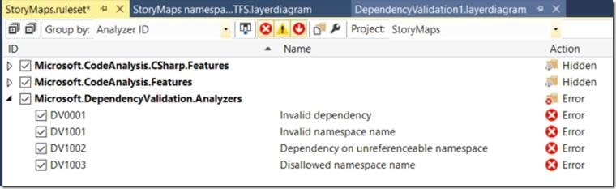
VS2017 – DV00XX – Dependency Validation
These don’t seem to be in vs2017 any more. Cannot locate.
Notes:
JHEALY – CANNOT FIND THESE IN RC3
https://blogs.msdn.microsoft.com/visualstudioalm/2016/11/30/live-dependency-validation-in-visual-studio-2017/
Error Code
When is it reported?
DV0001
Invalid Dependency. This issue is reported when a code element (namespace, type, member) mapped to a Layer references a code element mapped to another layer, but there is no dependency arrow between these layers in the dependency validation diagram containing this layers. This is a dependency constraint violation
DV1001
Invalid namespace name. This issue is reported on a code element associated with a layer which “Allowed Namespace Names” property does not contain the namespace in which this code element is defined. This is a naming constraint violation.
Note that the syntax of “Allowed Namespace Names” is to be a semi-colon list of namespaces in which code elements associated with are layer are permitted to be defined.
DV1002
Dependency on unreferenceable namespace. This issue is reported on a code element associated with a layer and referencing another code element defined in a namespace which is defined in the “Unreferenceable Namespace” property of the layer. This is a naming constraint violation.
Note that the “Unreferenceable Namespaces” property is defined as a Semi-colon separated list of namespaces that should not be referenced in code elements associated with this layer
DV1003
Disallowed namespace name. This issue is reported on a code element associated with a layer which “Disallowed Namespace Names” property contains the namespace in which this code element is defined. This is a naming constraint violation.
Note that the “Disallowed namespace name” property is defined as a Semi-colon separated list of namespaces in which code elements associated with this Layer should not be defined.

Slide 27
VS2017 Analyzer Deltas
Microsoft.CodeAnalysis.CSharp [-] CS0028 Method has the wrong signature to be an entry point [-] CS0402 An entry point cannot be generic or in a generic type [-] CS7022 The entry point of the program is global script code [+] CS8123 The tuple element name is ignored because a different name is specified by the assignment target
Microsoft.CodeAnalysis.CSharp.EditorFeatures [+] IDE0007 Use implicit type [+] IDE0008 Use explicit type [+] IDE0009 Member access should be qualified [+] IDE0011 Add braces [+] IDE0012 Simplify Names [+] IDE0013 Simplify Names [+] IDE0014 Use framework type [+] IDE0015 Use framework type [+] IDE0016 Use ‘throw’ expression [+] IDE0017 Simplify object initialization [+] IDE0018 Inline variable declaration [+] IDE0019 Use pattern matching [+] IDE0020 Use pattern matching [+] IDE0021 Use expression body for methods [+] IDE0022 Use expression body for operators [+] IDE0023 Use expression body for operators [+] IDE0024 Use expression body for properties [+] IDE0025 Use expression body for indexers [+] IDE0026 Use expression body for accessors [+] IDE0027 Simplify colection initialization [+] IDE0028 Use coalesce expression [+] IDE0029 Use coalesce expression [+] IDE0030 Use null propogation [+] IDE1005 Delegate invocation can be simplified [+] IDE1006 Naming Styles
Microsoft.CodeAnalysis.Features [+] IDE0010 Add missing cases [+] IDE0032 Use explicity provided tuple name
Microsoft.Rules.Managed [-] CA2123 Override link demands should be identical to base [-] CA2130: Security critical constants should be transparent [-] CA2131: Security critical types may not participate in type equivalence [-] CA2132: Default constructors must be at least as critical as base type default constructors [-] CA2133: Delegates must bind to methods with consistent transparency [-] CA2134: Methods must keep consistent transparency when overriding base methods [-] CA2135: Level 2 assemblies should not contain LinkDemands [-] CA2136: Members should not have conflicting transparency annotations [-] CA2137: Transparent methods must contain only verifiable IL [-] CA2138: Transparent methods must not call methods with the SuppressUnmanagedCodeSecurity attribute [-] CA2139: Transparent methods may not use the HandleProcessCorruptingExceptions attribute [-] CA2140: Transparent code must not reference security critical items [-] CA2141:Transparent methods must not satisfy LinkDemands [-] CA2142: Transparent code should not be protected with LinkDemands [-] CA2143: Transparent methods should not use security demands [-] CA2144: Transparent code should not load assemblies from byte arrays [-] CA2145: Transparent methods should not be decorated with the SuppressUnmanagedCodeSecurityAttribute [-] CA2146: Types must be at least as critical as their base types and interfaces [-] CA2147: Transparent methods may not use security asserts [-] CA2149: Transparent methods must not call into native code [-] CA2151: Fields with critical types should be security critical. [-] CA5122: P/Invoke declarations should not be safe-critical
Microsoft.VisualStudio.Azure.Fabric.DiagnosticAnalyzers [+] SF1001 The name of a service type has not been consistently applied in all places [+] SF1002 Assembly name and serviceentry point are inconsistent across project and manifest
https://blogs.msdn.microsoft.com/devfish/2017/02/02/roslyn-analyzer-deltas-for-vs2017-rc3/

Slide 28
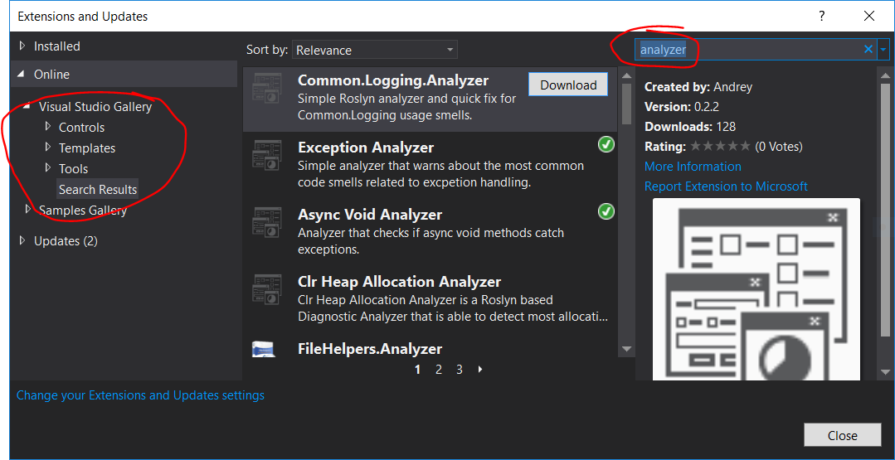
Machine Wide Analyzers via Extensions
Tools > Extensions and Updates
Search Analyzers
Installed machine wide
Always available in rulesets unless turned off

Slide 29
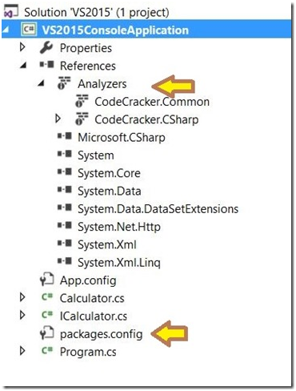
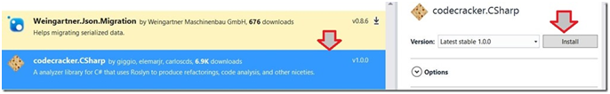
Project level analyzers via NuGet
[right-mouse] project
Manage NuGet packages
Search “Analyzer”
Install lib

Slide 30
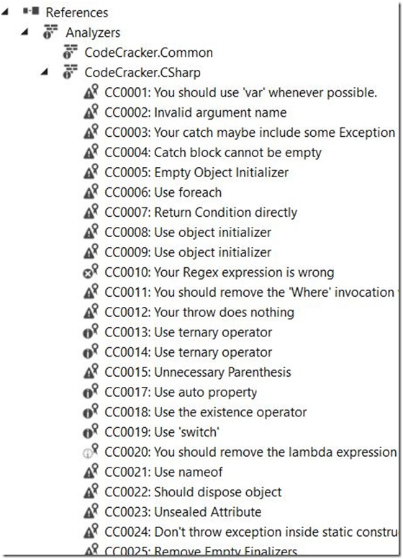
Project level analyzers via NuGet
[right-mouse] project
Manage NuGet packages
Search “Analyzer”
Install lib

Slide 31
Xamarin – Builtins don’t work with ios/droid but..
C:\orma\ORMA\ORMA\External\Foundation\AcuityBrands.Foundation.iOS\BluetoothLE\iOSBleAdapter.cs(17):public class iOSBleAdapter : IBleAdapter
Iosbleadapter / line 191 / return null
Iosbleadapter / line 330 / firstordefault v find
Androidbleadapter.cs / line 99 / explore loop

Slide 32
Builds and Checkins
Can be used to block Check-Ins – Quality Gates
https://msdn.microsoft.com/en-us/library/dd264876.aspx
Run as part of VSTS Build - https://social.msdn.microsoft.com/Forums/en-US/d006edf6-8c4d-40a8-aa97-cf29f940ca59/tfs-2015-build-how-to-run-code-analysis?forum=tfsbuild

Slide 33









Custom RuleSet Creation for Client
Tell me, show me!

Slide 34
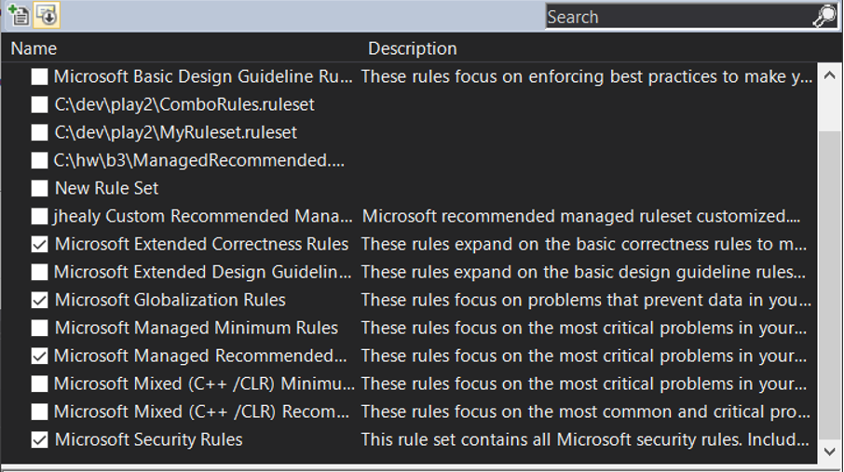
Base Analyzer Set
Install at machine level!
Base Analyzer Rule Set - those supplied with ide.
Add following Analyzers to a custom Ruleset
Microsoft Extended Correctness Rules
Microsoft Globalization Rules
Microsoft Security Rules
Microsoft Manage Code Recommended Rules
Enable Following Rules
CA1002 - Do not expose generic lists
CA2000 - Dispose check - catches several IDisposable pattern violations
Disable Following Rules
CA2210 - Strong name key should be used for assemblies. Revisit after standardizing build architecture.
CA2204 - Literals should be spelled correctly - Styling Standardization is not a concern at this point for already existing errors.

Slide 35
Managed Binary Analysis (CAxx) Rules
Apply against compiled code
Projects must be fully built to get ruleset applied
May not show up if you have errors

Slide 36
Can’t Find What You Like, Create Your Own
Out of scope for this talk
Getting Started Writing a Custom Analyzer & Code Fix - https://github.com/dotnet/roslyn/wiki/Getting-Started-Writing-a-Custom-Analyzer-&-Code-Fix
Power of Roslyn: Improving Your Productivity with Live Code Analyzers - Xam Evolve 2016 - https://channel9.msdn.com/events/Xamarin-Evolve/2016/The-Power-of-Roslyn-Improving-Your-Productivity-with-Live-Code-Analyzers
Lots of open source analyzers out there for you to peruse

Slide 37
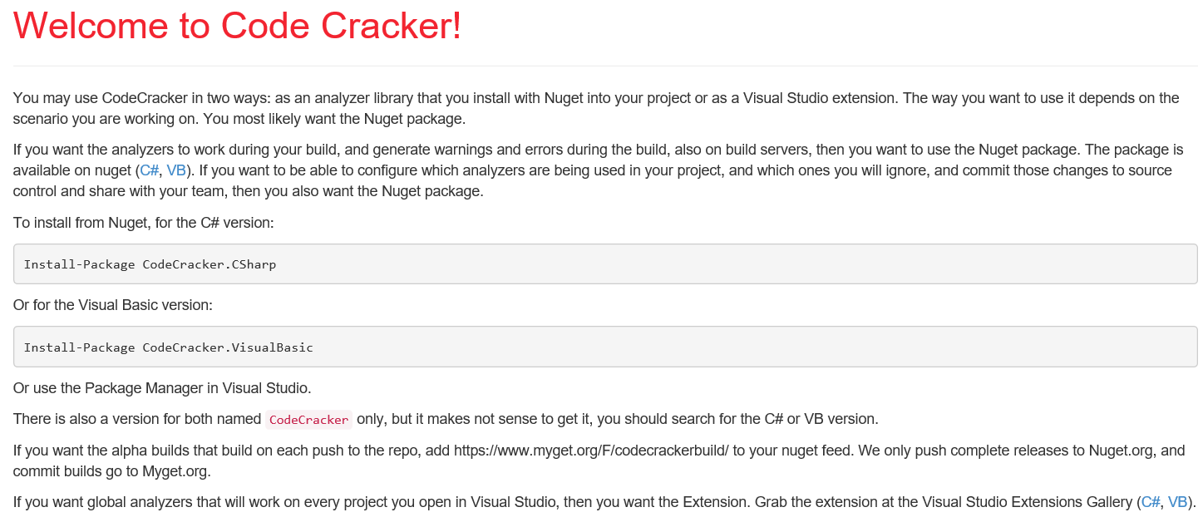
Code Cracker for C#
Open source
Good value showdn with empty catch blocks, improper IDisposable usage and patterns, performance gains through static methods, improper usage of XML comments….
Remove following rules from RuleSet to reduce "noise"
CC0001 - Var Instead of Type Name - debatable
CC0003 - currently implemented pattern works, not worth time at this point
CC0008 - You can use initializers in here - debatable
CC0015 - Remove unnecessary parenthesis. - style issue, debatable
CC0037 - Commented code should be removed
CC0065 - Remove trailing whitespace
CC0105 - Use 'var' instead of specifying the type name – debatable
https://github.com/code-cracker

Slide 38
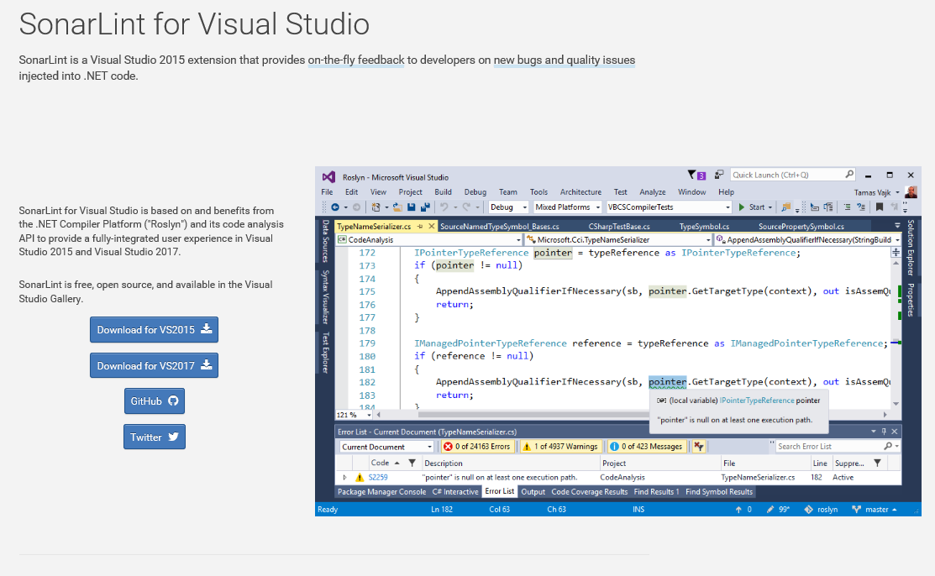
SonarLint
Open source
unused code, empty methods, globalization, unused variables, string anti-patterns, unused but assigned local variables, property anti-patterns, and empty exception blocks
Remove following rules from base SonarLint RuleSet to reduce "noise"
S100 - Rename method to match camel case
S125 - Remove commented out code
S1450 - Remove the {fieldname} field and declare it as a local variable in the relevant methods.
S2360 - Use the overloading mechanism instead of the optional parameters.
S2933 - Make "_log" "readonly"
Version 2.0 allows a connection to a SonarQube server. Bind your Visual Studio solution to a SonarQube project. Automatically updates the rulesets of the solution and attaches the required Roslyn analyzers to the solution.
http://www.sonarlint.org/visualstudio/index.html

Slide 39
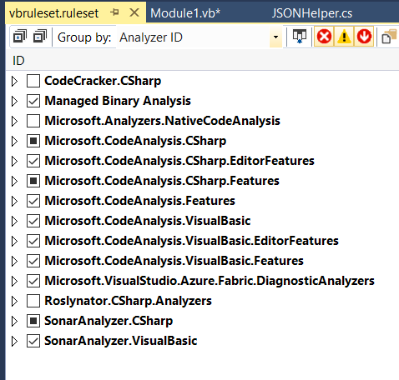
Rules for VB

Slide 40
Other Rulesets I would Use Now
More, more, more….

Slide 41
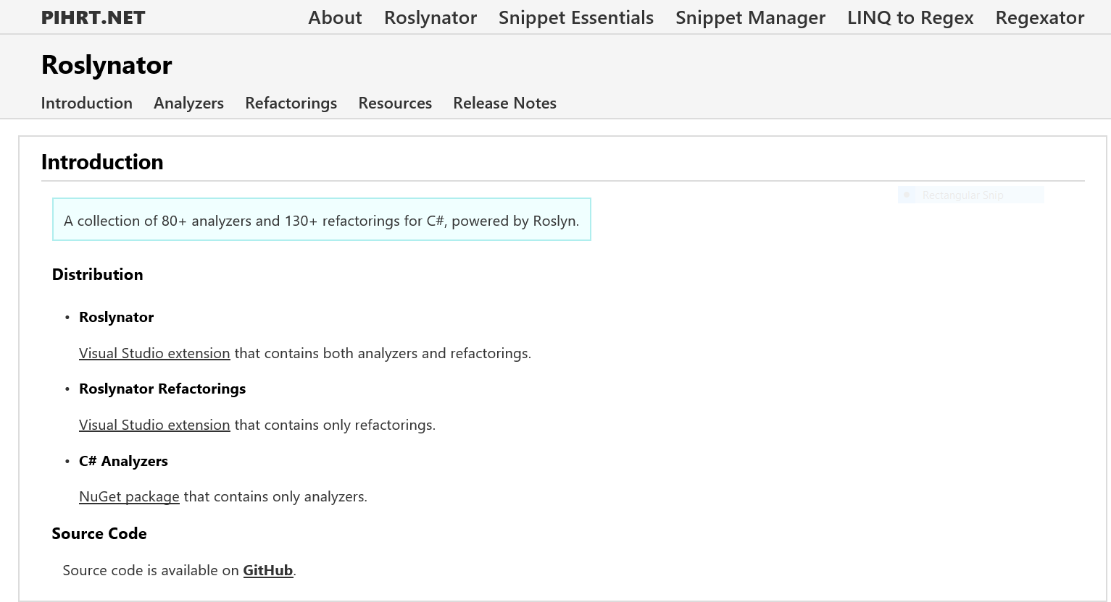
Roslynator
Authored by Joseph Pihrt
Open source
80 analyzers and more than 130+ refactorings for C#
RCS1001 Add braces >> RCS1003 Add braces to if-else >> RCS1005 Simplify nested using statement >> RCS1006 Merge else clause with nested if statement >> RCS1008 Use explicit type instead of 'var' (when the type is not obvious) >> RCS1009 Use explicit type instead of 'var' (foreach variable) >>RCS1023 Format empty block >> RCS1039 Remove empty attribute argument list >> RCS1040 Remove empty else clause >> RCS1041 Remove empty initializer >> RCS1042 Remove enum default underlying type >> RCS1046 Asynchronous method name should end with 'Async' >> RCS1047 Non-asynchronous method name should not end with 'Async' >> RCS1048 Replace anonymous method with lambda expression >> RCS1075 Avoid empty catch clause that catches System.Exception >> RCS1113 Use 'string.IsNullOrEmpty' method >> .. More ..
http://pihrt.net/Roslynator

Slide 42
Explore Various Analyzer Packs
Wintellect Analyzers - https://github.com/Wintellect/Wintellect.Analyzers
Roslyn Security Guard - https://dotnet-security-guard.github.io
Top 20 NuGet Analyzer Packages - http://nugetmusthaves.com/Tag/analyzers
https://github.com/DotNetAnalyzers
http://dfwiki.devfish.net/technology.Analyzers.ashx

Slide 43






Running the Rules
Eh? I turned them off, there were too many of them!
They were all code styling things….

Slide 44
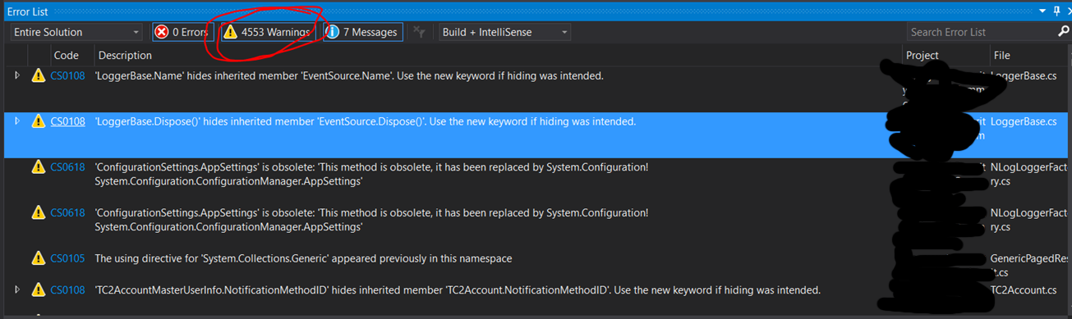
Running the Rules
Oops, 4553 warnings? Hey, I’m pretty sure I can ignore all them!

Slide 45

Suppressing Warnings
Able to exclude errors and warnings
Turn off rule in ruleset
Global suppression file
Inline with your code on a case by case basis

Slide 46
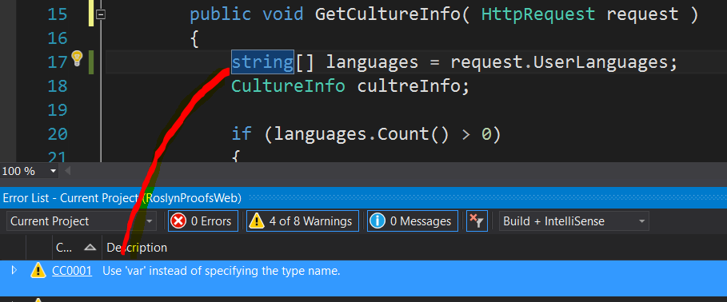
Suppressing Warnings
Var – I hate var – it’s a personal thing
The great var debate - https://github.com/code-cracker/code-cracker/issues/783
Web > EnumerableProofs.cs
Notes:
The great VAR debate - https://github.com/code-cracker/code-cracker/issues/783

Slide 47
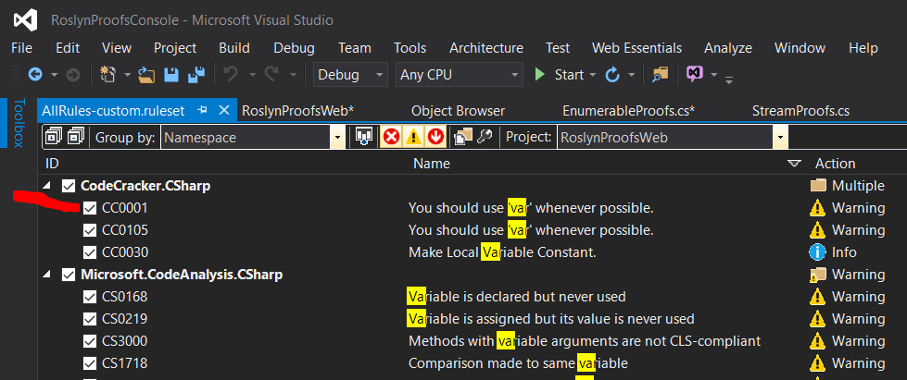
Suppressing Warnings – Turn off in Ruleset
Works for anything using ruleset
Problem – sometimes you may need the rule
Goodness – Easy peasy
Web > EnumerableProofs.cs

Slide 48
Suppressing Warnings – Turn off in Ruleset
Works for anything using ruleset
Problem – sometimes you may need the rule
Goodness – Easy peasy
<?xml version="1.0" encoding="utf-8"?>
<RuleSet Name="AllRules-custom" ToolsVersion="14.0">
<Include Path="allrules.ruleset" Action="Default" />
<Rules AnalyzerId="CodeCracker.CSharp" RuleNamespace="CodeCracker.CSharp">
<Rule Id="CC0001" Action="None" />
</Rules>
</RuleSet>
Web > EnumerableProofs.cs

Slide 49
Suppressing Warnings – Block out in code
Use #pragma to disable a warning
Document WHY you disabled a warning
public void GetCultureInfo( HttpRequest request )
{
#pragma warning disable CC0001 // You should use 'var' whenever possible.
string[] languages = request.UserLanguages;
#pragma warning restore CC0001 // You should use 'var' whenever possible.
CultureInfo cultreInfo;
Web > EnumerableProofs.cs

Slide 50
Suppressing Warnings – Global Suppression File
Per project level
Must reproduce in each project
Potential for ‘shared’ file across solution but would require manual adds for new rules
GlobalSupression.cs….
[assembly: System.Diagnostics.CodeAnalysis.SuppressMessage(
"Style",
"CC0001:You should use 'var' whenever possible.",
Justification = "<Pending>“,
Scope = "member",
Target = "~M:RoslynProofsConsole.EnumerableProofs.GetCultureInfo(System.Web.HttpRequest)")]

Slide 51
Dump to File
IDE is great
How to push to a file in msbuild?
msbuild.exe .\RoslynProofs\RoslynProofs.sln /p:RunCodeAnalysis=True /t:rebuild
Using shared compilation with compiler from directory: C:\Program Files (x86)\MSBuild\14.0\bin
LogUtils.cs(13,23): warning CS0108: 'LoggerBase.Name' hides inherited member 'EventSource.Name'. Use the new keyword if hiding was intended. [C:\dev\RoslynProofsGit\RoslynProofs\RoslynProofsConsole\RoslynProofsConsole.csproj]
ProfileHelpers.cs(75,17): warning CS0472: The result of the expression is always 'true' since a value of type 'CanProfile' is never equal to 'null' of type 'CanProfile?' [C:\dev\RoslynProofsGit\RoslynProofs\RoslynProofsConsole\RoslynProofsConsole.csproj]
ResourceHelpers.cs(38,33): warning CS0649: Field 'ResourceHelpers.CustomResourceReader._resources' is never assigned to, and will always have its default value null [C:\dev\RoslynProofsGit\RoslynProofs\RoslynProofsConsole\RoslynProofsConsole.csproj]
ResourceHelpers.cs(40,32): warning CS0169: The field 'ResourceHelpers.CustomResourceReader.manager' is never used [C:\dev\RoslynProofsGit\RoslynProofs\RoslynProofsConsole\RoslynProofsConsole.csproj]
animals\People.cs(12,16): warning CS0414: The field 'People.RequiredFieldErrorMessage' is assigned but its value is never used [C:\dev\RoslynProofsGit\RoslynProofs\RoslynProofsConsole\RoslynProofsConsole.csproj]
animals\People.cs(13,16): warning CS0414: The field 'People.DateFieldErrorMessage' is assigned but its value is never used

Slide 52
Rule and Analysis Demo
DEMO

Slide 53

Overview of Violations
Imported to Excel ( tricky with large numbers of warnings )
Removed Internationalization
Remove most style violations
Graded violations low, medium, high
About 900 violations to look at left

Slide 54
Grading Defects by Area
Exception Patterns – using exceptions properly in for optimal performance and diagnostic abilities.
Memory – memory or resource leak candidates. Improper Dispose pattern usage is a key player.
Craftsmanship – or clean code. Good coding patterns, avoiding dangerous coding patterns.
OO Patterns – are properties properly implemented, virtual members being respected.
Performance – Coding tweaks to improve system performance overall.

Slide 55
Client Example: Defects by Area
Distinct | Count
Exception Pattern | 241
Memory | 208
Craftsmanship | 201
OO Patterns | 168
Performance | 76
Total | 894

Slide 56
Client Example: Defects by Project
Project | Violations
Repository | 270
Web.Utils.Service.Client | 208
Entity | 142
Web.Shell | 58
Provider | 49
Common.Helpers | 25
Web.ViewModels | 20
Common.AuditLog | 18
Mobile.Web | 17
RadioModel | 9
Common.isomHelpers | 7

Slide 57
Client Example: Defects by File
AccountManagementClient.cs 69
CommunicatorProgramming.cs 61
CommunicatorProgrammingClient.cs 46
AccountManagement.cs 44
TCAccountManagementClient.cs 34
PanelNotification.cs 27
PanelNotificationClient.cs 26
ReportsMangement.cs 22
ReportManagementMDX.cs 20
TemplateManagementController.cs 20
PanelConfiguration.cs 18
FirmwareJob.cs 17
RadioModelUnitTest.cs 17
UserManagement.cs 14
AuditLogConstant.cs 12
FirmwareManagementClient.cs 12
CommunicatorProgrammingProvider.cs 11
AuthenticationClient.cs 11
TCAccountManagementProvider.cs 10
PanelConfigurationProvider.cs 10
SystemConfigController.cs 10

Slide 58
Reviewing the Code
Take a look at some errors.
What’s wrong with them?
How were they caught?
Should we suppress them or fix them?
Is this something systemic? Do we need to fix it across all of our systems?

Slide 59
Spot the problem
// bad code
string[] languages = Request.UserLanguages;
if (languages.Count() > 0) {}

Slide 60
Use Any() over Count() on IEnumerable [S1115]
string[] languages = Request.UserLanguages;
if (languages.Any()) {}
string[] languages = Request.UserLanguages;
if (languages.Count() > 0) {}
Caught by SonarLint S1115
Note stock rules do not catch this
28 times over 13 files just for this one snippet
Example: AccountManagementController.cs – line 763
Perf boost!
Use Count if you're using a list - knows the size.
Use Length for an Array
Use Any() for IEnumerable - stops after checking one item.
Web > EnumerableProofs.cs

Slide 61
Spot the problem
Public Shared Function WriteLog(ByVal message As String) As Boolean
If IsPerforamaceLogingOn Then
SyncLock GetType(Logger)
Dim fi = GetFile() ' RETURNS A STREAMWRITER
If fi IsNot Nothing Then
fi.Write(message)
fi.Write(vbCrLf)
fi.Flush()
fi.Close()
fi.Dispose()
Return True
Else
Return False
End If
End SyncLock
End If
End Function

Slide 62
Not all paths return a value – [BC42353]
Public Shared Function WriteLog(ByVal message As String) As Boolean
If IsPerforamaceLogingOn Then
SyncLock GetType(Logger)
Dim fi = GetFile() ' RETURNS A STREAMWRITER
If fi IsNot Nothing Then
fi.Write(message)
fi.Write(vbCrLf)
fi.Flush()
fi.Close()
fi.Dispose()
Return True
Else
Return False
End If
End SyncLock
End If
End Function

Slide 63
Object is Disposed more than once - VB [CA2202]
Public Shared Function WriteLog(ByVal message As String) As Boolean
If IsPerforamaceLogingOn Then
SyncLock GetType(Logger)
Dim fi = GetFile() ' RETURNS A STREAMWRITER
If fi IsNot Nothing Then
fi.Write(message)
fi.Write(vbCrLf)
fi.Flush()
fi.Close()
fi.Dispose()
Return True
Else
Return False
End If
End SyncLock
End If
End Function

Slide 64
Spot the problem
public class JSONPSupportBehaviorAttribute
: Attribute, IServiceBehavior
{
void IServiceBehavior.AddBindingParameters(ServiceDescription serviceDescription,
ServiceHostBase serviceHostBase,
System.Collections.ObjectModel.Collection<ServiceEndpoint> endpoints,
BindingParameterCollection bindingParameters)
{}
void IServiceBehavior.Validate(ServiceDescription serviceDescription,
ServiceHostBase serviceHostBase)
{}
HINT: This is an exact block from Client code. Everything included
Console > ServiceUtils.cs

Slide 65
Methods should not be empty [S1186]
Do not leave empty, undocumented methods
Unintentional omission – fix the error.
It is not yet, or never will be, supported, but the interface must be maintained., throw a NotSupportedException.
If the method is intentionally-blank override comment, explain, and suppress the warning.
If not used or required. Remove the empty method.
public class JSONPSupportBehaviorAttribute
: Attribute, IServiceBehavior
{
void IServiceBehavior.AddBindingParameters(ServiceDescription serviceDescription,
ServiceHostBase serviceHostBase,
System.Collections.ObjectModel.Collection<ServiceEndpoint> endpoints,
BindingParameterCollection bindingParameters)
{}
void IServiceBehavior.Validate(ServiceDescription serviceDescription,
ServiceHostBase serviceHostBase)
{}
Console > ServiceUtils.cs

Slide 66
Spot the problem
try
{
DbConn.ExecuteNonQuery(cmd);
int.TryParse(DbConn.GetParameterValue(cmd, "@Presult").ToString(), out objDataReader);
}
catch (Exception ex)
{
throw ex;
}
if (objDataReader > 0)
return true;
else
return false;
Console > DBUtils.cs

Slide 67
TryParse results not checked [CA1806]
string cmd = "cmd nothing here";
Int32 objDataReader = -1;
bool okParsed = int.TryParse(this.GetParameterValue(cmd, "@Presult").ToString(), out objDataReader);
return (okParsed && (objDataReader != -1));
try
{
DbConn.ExecuteNonQuery(cmd);
int.TryParse(DbConn.GetParameterValue(cmd, "@Presult").ToString(), out objDataReader);
}
catch (Exception ex)
{
throw ex;
}
if (objDataReader > 0)
return true;
else
return false;
Console > DBUtils.cs

Slide 68
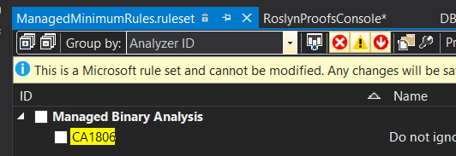
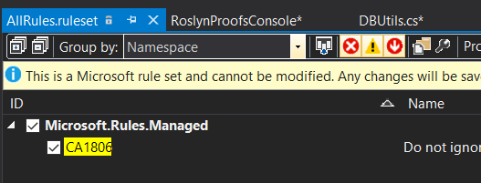
TryParse results not checked [CA1806]
Watch out!
Not in included in Managed Rulesets
Moral: Review your rulesets!
Console > DBUtils.cs

Slide 69
Spot the Problem
public bool CanContact( CanProfile profile )
{
bool retval = false;
switch ( profile )
{
case CanProfile.DoNotProfile:
retval = false;
break;
case CanProfile.Caution:
retval = true;
break;
case CanProfile.None:
retval = false;
break;
case CanProfile.Yes:
retval = true;
break;
default :
retval = false;
break;
}
return retval;
}
Console > DBUtils.cs

Slide 70
Few Fixes
public bool CanContact( CanProfile profile )
{
bool retval = false;
switch ( profile )
{
case CanProfile.DoNotProfile:
retval = false;
break;
case CanProfile.Caution:
retval = true;
break;
case CanProfile.None:
retval = false;
break;
case CanProfile.Yes:
retval = true;
break;
default :
retval = false;
break;
}
return retval;
}
CC0091 – Make method static
S1871 - Either merge this case with the identical one on line nn
CC0073 – Add braces to each section
Console > DBUtils.cs

Slide 71
Happier
public static bool CanContactBetter(CanProfile profile)
{
bool retval;
switch (profile)
{
case CanProfile.Yes:
case CanProfile.Caution:
{
retval = true;
break;
}
case CanProfile.DoNotProfile:
case CanProfile.None:
default:
{
retval = false;
break;
}
}
return retval;
}
CC0091 – Make method static
S1871 - Either merge this case with the identical one on line nn
CC0073 – Add braces to each section
Console > DBUtils.cs

Slide 72
Spot the problem
public enum CanProfile
{
Yes=11,
Caution=27,
DoNotProfile=301
}
Console > AnimalFactory.cs

Slide 73
CA1008 – Enums should have a zero value
public enum CanProfile
{
None=0,
Yes=11,
Caution=27,
DoNotProfile=301
}
Enums default to zero
Have default zero of “None” at the very least
Console > AnimalFactory.cs

Slide 74
Spot the problem
public enum CanProfile
{
None=0,
Yes=1,
Caution=2,
DoNotProfile=3
}
/.../
public bool CheckProfile(ItemWithProfile obj )
{
bool retval = false;
CanProfile tempProfileID;
Enum.TryParse<CanProfile>(obj.Profilable.ToString(), out tempProfileID);
if (tempProfileID != null)
{ … }
return retval;
}
Console > ProfileHelpers.cs

Slide 75
HINT: Code is never executed [CS0472]
public bool CheckProfile(ItemWithProfile obj )
{
bool retval = false;
CanProfile tempProfileID;
Enum.TryParse<CanProfile>(obj.Profilable.ToString(), out tempProfileID);
if (tempProfileID != null)
{ … }
return retval;
}
Console > ProfileHelpers.cs

Slide 76
HINT: Code is never executed [CS0472]
public bool CheckProfile(ItemWithProfile obj )
{
bool retval = false;
CanProfile tempProfileID;
Enum.TryParse<CanProfile>(obj.Profilable.ToString(), out tempProfileID);
if (tempProfileID != null)
{ … }
return retval;
}
CanProfile is an enum
Enums are never null
Use proper TryParse result checking
Console > ProfileHelpers.cs

Slide 77
Code is never executed [CS0472]
public bool CheckProfile(ItemWithProfile obj )
{
bool retval = false;
CanProfile tempProfileID;
Enum.TryParse<CanProfile>(obj.Profilable.ToString(), out tempProfileID);
if (tempProfileID != null)
{ … }
return retval;
}
CanProfile is an enum
Enums are never null
Also use proper TryParse result checking [CA1806]
Console > ProfileHelpers.cs

Slide 78

The Big “D”

Slide 79
Spot the problem
public static string Serialize(object obj)
{
StringWriter writer = new StringWriter();
new SpecialFormatter().Serialize(writer, obj);
return writer.ToString();
}
Console > Feline.cs

Slide 80
“D” is for dispose
Objects that implement IDisposable should be disposed
Be cautious around IDisposable objects in inheritance
Read about patterns for closing or disposing IDisposable – not all are the same
Console > Feline.cs

Slide 81
Object should be disposed [CA2237, CC0022]
public static string SerializeBetter(object obj)
{
using (StringWriter writer = new StringWriter())
{
SpecialFormatter.SerializeBetter(writer, obj);
return writer.ToString();
}
}
Console > Feline.cs

Slide 82
Spot the problem
using (StreamWriter streamWriter = new System.IO.StreamWriter(@"out.txt"))
{
string json = new JavaScriptSerializer().Serialize(value);
streamWriter.Write(json);
streamWriter.Flush();
streamWriter.Close();
}
Web > JSONHelper.cs

Slide 83
Object is Disposed more than once [CA2202]
using (StreamWriter streamWriter = new System.IO.StreamWriter(@"out.txt"))
{
string json = new JavaScriptSerializer().Serialize(value);
streamWriter.Write(json);
streamWriter.Flush();
streamWriter.Close();
}
Web > JSONHelper.cs

Slide 84
Object is Disposed more than once - VB [CA2202]
Public Shared Function WriteLog(ByVal message As String) As Boolean
If IsPerforamaceLogingOn Then
SyncLock GetType(Logger)
Dim fi = GetFile() ' RETURNS A STREAMWRITER
If fi IsNot Nothing Then
fi.Write(message)
fi.Write(vbCrLf)
fi.Flush()
fi.Close()
fi.Dispose()
Return True
Else
Return False
End If
End SyncLock
End If
End Function

Slide 85
Spot the problem
protected virtual void Dispose(bool disposing)
{
if (!disposed)
{
if (disposing)
{
// Free other state (managed objects).
}
ptSupportAPIClient = null;
disposed = true;
}
}

Slide 86
Disposable field should be disposed [CA1001][CA2213]
Exact error was -
Warning CA2213 'PTSupportSetup' contains field 'PTSupportSetup.ptSupportAPIClient' that is of
IDisposable type: 'Service1SoapClient'.
Change the Dispose method on 'PTSupportSetup' to call Dispose or Close on this field.
Common.ExternalServiceClient
Common\ExternalServiceClient\PTSupportSetup.cs 62
protected virtual void Dispose(bool disposing)
{
if (!disposed)
{
if (disposing)
{
// Free other state (managed objects).
}
ptSupportAPIClient = null;
disposed = true;
}
}

Slide 87
Spot the problem
public abstract class LoggerBase : EventSource, ILogger, IDisposable
{
…
public void Dispose()
{
GC.SuppressFinalize(this);
}
NO SAMPLE

Slide 88
Modify to call Dispose(true) and GC.SupressFinalize [CA1063]
// PROPER DISPOSE PATTERN
public void Dispose()
{
Dispose(true);
GC.SuppressFinalize(this);
}
protected virtual void Dispose(bool disposing)
{
if (disposing)
{
// free managed resources
if (managedResource != null)
{
managedResource.Dispose();
managedResource = null;
}
}
// free native resources if there are any.
if (nativeResource != IntPtr.Zero)
{
Marshal.FreeHGlobal(nativeResource);
nativeResource = IntPtr.Zero;
}
}
public abstract class LoggerBase
: EventSource, ILogger, IDisposable
{
…
public void Dispose()
{
GC.SuppressFinalize(this);
}
NO SAMPLE

Slide 89
Spot the problem
public abstract class LoggerBase : EventSource, ILogger, IDisposable
{
private ILoggerFactory factory;
public abstract bool IsDebugEnabled
{
get;
}
Cons > LogUtils.cs

Slide 90
Remove IDisposable from the list of Interfaces [CA1063]
public abstract class LoggerBase : EventSource, ILogger, IDisposable
{
private ILoggerFactory factory;
public abstract bool IsDebugEnabled
{
get;
}
Cons > LogUtils.cs

Slide 91
Spot the problem
try
{
var hubConnection = new HubConnection(url, new Dictionary<string, string> {{ "UserName", _hubUserName },{ "UserToken", usertoken.ToString() }}); hubConnection.CookieContainer = handler.CookieContainer;
// more stuff
}
catch (Exception ex)
{
_log.Error(ex, "HubNotificationHandler::SubscribeToHubByAddress - Exception : " + ex.Message);
}
Cons > LogUtils.cs

Slide 92
HubConnection is never disposed[CA2000][CA2202]
try
{
var hubConnection = new HubConnection(url, new Dictionary<string, string> {{ "UserName", _hubUserName },{ "UserToken", usertoken.ToString() }}); hubConnection.CookieContainer = handler.CookieContainer;
// more stuff
}
catch (Exception ex)
{
_log.Error(ex, "HubNotificationHandler::SubscribeToHubByAddress - Exception : " + ex.Message);
}

Slide 93
HubConnection is never disposed[CA2000][CA2202]
Investigate before just implementing dispose
You can dispose each connection
SignalR Hub Connections can also use a Singleton pattern with a single instance
https://msdn.microsoft.com/en-us/library/microsoft.aspnet.signalr.client.hubconnection.dispose

Slide 94
Spot the problem
string result = string.Empty;
try
{
EightBallServiceClient client = new EightBallServiceClient();
result = client.AskQuestion(question);
client.Close();
}
Cons > EightBallHelper.cs

Slide 95
Spot the problem
string result = string.Empty;
try
{
EightBallServiceClient client = new EightBallServiceClient();
result = client.AskQuestion(question);
client.Close();
}
CA2000 ?? EightBallServiceClient should be disposed?
OK – so then…
*** Not picked up by Analyzer, but by PFE Code review tool
Hint: Eightball is of type System.ServiceModel.ClientBase
Cons > EightBallHelper.cs

Slide 96
Spot the problem
HINT: WCF Service from client code
using ( EightBallServiceClient client = new EightBallServiceClient() )
{
return client.AskQuestion(question);
}
Hint: Not picked up by Analyzer, but by PFE Code review tool
Hint: Eightball is of type System.ServiceModel.ClientBase
Cons > EightBallHelper.cs

Slide 97
Avoid disposing WCF objects implementing ICommunicationObject
Wt heck?
Do not use “using to clean up WCF objects”
C# "using" statement results in a call to Dispose()
Same as Close(), which may throw exceptions when a network error occurs.
Exceptions are likely to go unnoticed
Fix by only calling Close() if the object has not faulted
If object faults call Abort() instead
NOT picked up by analyzer but by PFE code review tool
Cons > EightBallHelper.cs

Slide 98
Avoid disposing WCF objects implementing ICommunicationObject
http://msdn.microsoft.com/en-us/library/aa355056.aspx
try
{
...
client.Close();
}
catch (CommunicationException e)
{
...
client.Abort();
}
catch (TimeoutException e)
{
...
client.Abort();
}
catch (Exception e)
{
...
client.Abort();
throw;
}
Cons > EightBallHelper.cs

Slide 99


Object Oriented Violations

Slide 100
Spot the OO problem
public abstract class LoggerBase : EventSource, ILogger, IDisposable
{
public string Name
{
get;
private set;
}
Cons > LgoUtils.cs

Slide 101
Hides inherited member [CA1063][S1939]
public abstract class LoggerBase : EventSource, ILogger, IDisposable
{
public string Name
{
get;
private set;
}
Code may be overriding or suppressing base class behavior
Particularly onerous when Dispose() comes into play
Modify class – remove property as its implemented in base class
Cons > LgoUtils.cs

Slide 102
Spot the OO problem
public class AppConst
{
public List<string> SupportedLangs = new List<string>()
{
"en-US", "en-en", "es-es", "fr-FR"
};
}
Web > EnumerableProofs.cs

Slide 103
Do not expose Generic lists [CA1002]
public class AppConst
{
public List<string> SupportedLangs = new List<string>()
{
"en-US", "en-en", "es-es", "fr-FR"
};
}
Performance implications
List is designed for performance not inheritance
Exposed in inheritable class
Occurs 1219 times
If the class is not designed to be inherited, seal it.
If you wish the class to be open to inheritance, the following generic collections are designed for inheritance and should be exposed instead of System.Collections.Generic.List<T>.
System.Collections.ObjectModel.Collection<T>
System.Collections.ObjectModel.ReadOnlyCollection<T>
System.Collections.ObjectModel.KeyedCollection<TKey, TItem>
Web > EnumerableProofs.cs

Slide 104
Spot the OO problem
[AttributeUsage(AttributeTargets.Class)]
public class JSONPSupportBehaviorAttribute : Attribute, IServiceBehavior
{
void IServiceBehavior.AddBindingParameters(
ServiceDescription serviceDescription, ServiceHostBase serviceHostBase,
System.Collections.ObjectModel.Collection<ServiceEndpoint> endpoints,
BindingParameterCollection bindingParameters) {}
void IServiceBehavior.ApplyDispatchBehavior(ServiceDescription serviceDescription, ServiceHostBase serviceHostBase) {}
void IServiceBehavior.Validate(ServiceDescription serviceDescription, ServiceHostBase serviceHostBase) {}
}
Cons > ServiceUtils.cs

Slide 105
Interface methods should be callable by child types [CA1033]
Inheritance issues - Make 'MyClass' sealed (a breaking change if this class has previously shipped), implement the method non-explicitly, or implement a new method that exposes the functionality of ‘IInterfaceThing' and is visible to derived classes.
[AttributeUsage(AttributeTargets.Class)]
public class JSONPSupportBehaviorAttribute : Attribute, IServiceBehavior
{
void IServiceBehavior.AddBindingParameters(
ServiceDescription serviceDescription, ServiceHostBase serviceHostBase,
System.Collections.ObjectModel.Collection<ServiceEndpoint> endpoints,
BindingParameterCollection bindingParameters) {}
void IServiceBehavior.ApplyDispatchBehavior(ServiceDescription serviceDescription, ServiceHostBase serviceHostBase) {}
void IServiceBehavior.Validate(ServiceDescription serviceDescription, ServiceHostBase serviceHostBase) {}
}
Cons > ServiceUtils.cs

Slide 106
Exceptions

Slide 107
Spot the problem
try
{
if (DeviceType == "876" || DeviceType == "864")
{
Data = "PT" + Data.Substring(0, Data.IndexOf("m") - 1) + "M";
}
else
{
Data = "PT" + Data.Substring(0, Data.IndexOf("h") - 1) + "H";
}
}
catch
{}
Cons > LocalizedData.cs

Slide 108
Empty Catch Blocks are Bad [CC004][CA1031]
try
{
if (DeviceType == "876" || DeviceType == "864")
{
Data = "PT" + Data.Substring(0, Data.IndexOf("m") - 1) + "M";
}
else
{
Data = "PT" + Data.Substring(0, Data.IndexOf("h") - 1) + "H";
}
}
catch
{}
Why is it empty?
Its eating exceptions!
Comment with intent
Log the exception
Cons > LocalizedData.cs

Slide 109
Spot the problem
try
{
string cmd = "cmd nothing here";
Int32 objDataReader = -1;
bool okParsed = int.TryParse(this.GetParameterValue(cmd, "@Presult").ToString(), out objDataReader);
}
catch ( Exception ex )
{
throw ex;
}
Cons > DBUtils.cs

Slide 110
Rethrow to preserve stack details[CA2200][CC0012]
try
{
string cmd = "cmd nothing here";
Int32 objDataReader = -1;
bool okParsed = int.TryParse(this.GetParameterValue(cmd, "@Presult").ToString(), out objDataReader);
}
catch ( Exception ex )
{
// throw ex;
throw;
}
You lose stack details by throwing Exception
Rethrow original
Why is this exception block here at all? [this is real code]
Cons > DBUtils.cs

Slide 111
Spot the problem
var toAppend = String.Empty;
for (var index = 0; index < x1; index++)
{
toAppend += ".0";
}
Cons > StringHelper.cs

Slide 112
Spot the problem
private DateTime DTParsePlay( string msg )
{
DateTime retval;
try
{
retval = DateTime.Parse(msg);
}
catch
{
retval = DateTime.Now;
}
return retval;
}
Cons > LocalizedData.cs

Slide 113
Exceptions are Expensive
private DateTime DTParsePlay2(string date)
{
DateTime result;
if ( DateTime.TryParse( date, out result ) == false )
result = DateTime.Now;
return result;
}
Use TryParse instead of Parse
Lose the exception
Not actually caught by exception messages but abuse pattern makes you look closer
Cons > LocalizedData.cs

Slide 114
Don’t concatenate strings in a loop [CC0039][S1643]
StringBuilder toAppend = new StringBuilder(1024);
for(Int32 index = 0; index < x1; index++)
{
toAppend.Append(@".0");
}
var toAppend = String.Empty;
for (var index = 0; index < x1; index++)
{
toAppend += ".0";
}
Less CPU cycles, garbage collector work and overall time
Cons > StringHelper.cs

Slide 115
Spot the problem
// example #1
if ( String.IsNullOrEmpty(this.ZoneDescriptor1) && this.ZoneDescriptor1 != "0" )
{
this.ZoneDescriptor1 = this.ZoneDescriptor1.Trim(new char [] { '~' });
}
// example #2
obj.StatusName = String.IsNullOrEmpty ( objDataReader["LatestJobStatus"].ToString ) ? "Not Scheduled" : objDataReader["LatestJobStatus"].ToString();
Cons > LocalizedData.cs

Slide 116
Test for Empty Strings [CA1820]
// example #1
if (inisideItem.ZoneDescriptor1 != null && inisideItem.ZoneDescriptor1 != "0" && inisideItem.ZoneDescriptor1 != "")
{
inisideItem.ZoneDescriptor1 = inisideItem.ZoneDescriptor1.Trim(new char[]
{ '~' });
}
// example #2
obj.StatusName = objDataReader["LatestJobStatus"].ToString() ==
"" ? "Not Scheduled" : objDataReader["LatestJobStatus"].ToString();
“==” operator for string comparison to check for null and empty variablesis slower than other methods.
Equals is many more instructions than the equivalent method of IsNullOrEmpty
Cons > LocalizedData.cs

Slide 117
Spot the problem
//Fix for CustomerIssue-1117
if (string.Equals(pi.Name, "Notes", StringComparison.InvariantCultureIgnoreCase))
value = value.Replace("&#10;", System.Environment.NewLine);
Cons > LocalizedData.cs

Slide 118
Use ordinal StringComparison [CA1309]
if (string.Equals(pi.Name, "Notes", StringComparison.OrdinalIgnoreCase))
value = value.Replace("&#10;", System.Environment.NewLine);
if (string.Equals(pi.Name, "Notes", StringComparison.InvariantCultureIgnoreCase))
value = value.Replace("&#10;", System.Environment.NewLine);
Use nonlinguistic string comparison via Specify StringComparison.Ordinal or StringComparison.OrdinalIgnoreCase
Features specific to the natural language are ignored
Decisions are based on simple byte comparisons and ignore casing or equivalence tables that are parameterized by culture.
Code gains speed, increases correctness, and becomes more reliable.
Cons > LocalizedData.cs

Slide 119
Spot the problem
public class LocalizedData
{
public string Test;
public string NoparsingMethodAvailable;
public string NoOrInvalidDataPassed;
public string NotificationMessage;
public string HighSpeedNotificationMessage;
public string BatteryChargerFailure;
public string SecondaryCommunicationPathFailure;
public string NetworkAlertMessageReferEMail;
public string HighSpeedAlarmMessage;
public string Data;
Cons > LocalizedData.cs

Slide 120
Do not declare visible instance fields [CA1051]
public class LocalizedData
{
public string Test;
public string NoparsingMethodAvailable;
public string NoOrInvalidDataPassed;
public string NotificationMessage;
public string HighSpeedNotificationMessage;
public string BatteryChargerFailure;
public string SecondaryCommunicationPathFailure;
Fields should never be exposed publicly in a class.
Properties that just return the value of a private or internal field are optimized to perform on par with accessing a field.
Externally visible fields do not provide any benefits that are unavailable to properties
Cons > LocalizedData.cs

Slide 121
Spot the problem
public class ApplicationVersion
{
public static string applicationVersion;
…
}
public class SystemConfigController : BaseController
{
public static Dictionary<int, string> commModels;
…
}
Web > JobSchedulingHelper.cs

Slide 122
Non-constant fields should not be visible [CA2211][ S2223]
public class ApplicationVersion
{
public static string applicationVersion;
…
}
public class SystemConfigController : BaseController
{
public static Dictionary<int, string> commModels;
…
}
Static fields that are neither constants nor read-only are not thread-safe.
Static fields are best used to store data that does not change.
Make the public static fields into properties, OR declare them constant or read-only.
Web > JobSchedulingHelper.cs

Slide 123
Spot the problem
public ScheduleApproxStartTime ScheduleJob(JobScheduleEntity jobScheduleEntity)
{
int rc = 0;
DateTime schtime = DateTime.Now;
Notes:
Actually was caught via pfe code review tool

Slide 124
DateTime.UtcNow instead of DateTime.Now
public ScheduleApproxStartTime ScheduleJob(JobScheduleEntity jobScheduleEntity)
{
int rc = 0;
DateTime schtime = DateTime.Now;
DateTime.Now is in current machine time zone.
Especially relevant in web server scenarios
May not account for daylight savings time – introducing hard to detect time bug

Slide 125
Q&A
Code snippets at https://github.com/jhealy/RoslynAnalyzerProofs

